Slide 1
Mobile Commerce
ADM 3378

Slide 2
Agenda

Slide 3
Mobile Commerce
The use of wireless handheld devices such as cellular phones and laptops to conduct commercial transactions online. Mobile commerce transactions continues to grow, and the term includes the purchase and sale of a wide range of goods and services, online banking, bill payment, information delivery and so on. Also known as m-commerce.

Slide 4
Technologies
USSD (Unstructured Supplementary Service Data)
- 4% usage rate
- Used mostly in developing countries
- Pros: Easy to use, easy to implement
- Cons: Plain text (low security), missing security layers
BLE (Bluetooth Low Energy)
- 1Mbit/sec transfer rate, 10mW max power, 50m range
- 40% usage rate
- Pros: Most smartphones enabled, easy, low power, support
- Cons: Security (range), no backward compatibility
Notes:
- USSD similar to text messaging

Slide 5
Technologies
SMS (Short Message Service)
- 51% usage rate
- Pros: On nearly all mobile devices worldwide, Easy
- Cons: Expensive, asynchronous, lack of encryption
WAP (Wireless Application Protocol)
- 38% usage rate
- Pros: Better security than SMS / USSD / BLE, familiar (LTE), synchronous
- Cons: Expensive (pay for data)
QR codes
- 16% usage rate
- Pros: easy to use, convenient, good for adding information
- Cons: Only available on smartphones, security risks

Slide 6
Technologies
NFC (Apple Pay)
- Uses magnetic fields to send and receive information
- 8% usage rate (2013) – more since iPhone 6
- Pros: ~ 15-second processing, convenient, secure, compatible with RFID
- Cons: Needs additional hardware (SD/SIM), must download value-added services
Sound Wave Payment (Alipay Wallet)
- Uses ultrasonic sound waves to send information, which can be embedded in sound clips
- No usage statistics, but implemented in Alipay Wallet, so widely used
- Pros: No extra hardware needed for the consumer, low cost for retailer, easy
- Cons: Signal interference (environment-dependent), security
Notes:
NFC is supported by google and has been in development for a long time
Sound Wave Payment: can detect the source direction and signal strength to minimize the threat of man-in-the-middle attacks

Slide 7
Business Models and Strategy
Four main business models
MNO Driven or Operator Centric Model
Bank Centric Model
Independent or Peer-to-Peer Model
Collaborative Model

Slide 8
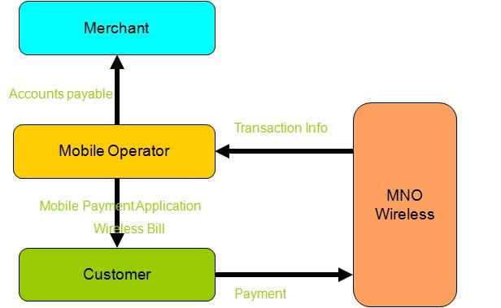
MNO Driven or Operator Centric Model
Mobile network providers (MNOs) design and distribute their own mobile applications
Revenue generated by:
charging to regular phone bill
prepaying for service

Slide 9
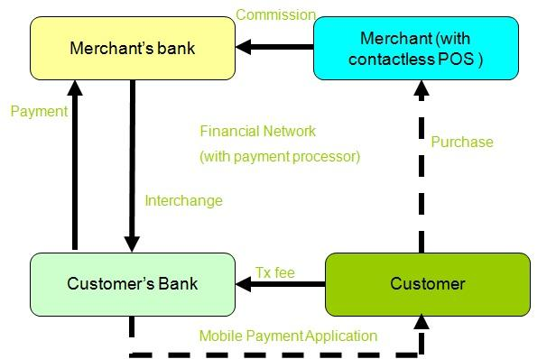
Bank Centric Model
Takes existing four corners model and puts it into a mobile context
Revenue generated by:
applying transaction fees for customers

Slide 10
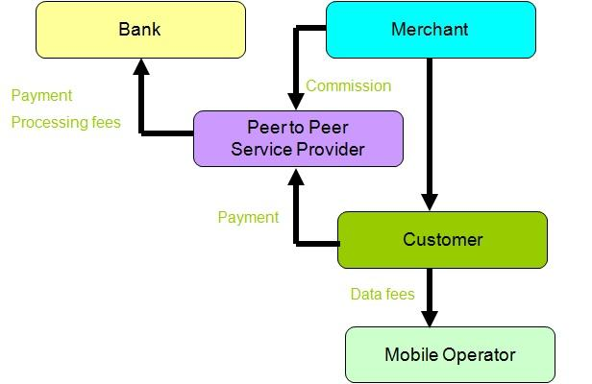
Independent or Peer-to-Peer Model
An independent service provider enables mobile payments
Seeks to avoid pre-existing payment systems to processing costs for transactions
May design and distribute an application for an NFC-enabled device

Slide 11
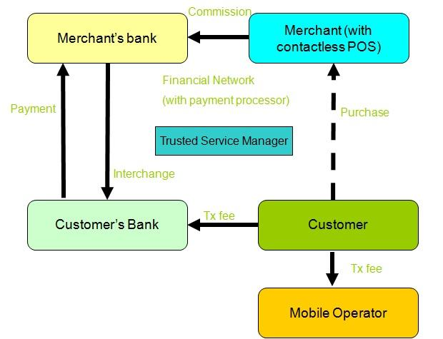
Collaborative Model
Requires the co-operation of both MNOs, banks and possibly a third party to manage the mobile application itself
Revenue generated by:
splitting the revenue generated through merchant fees

Slide 12
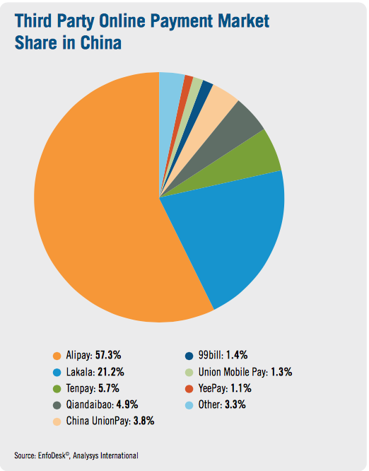
Alipay Wallet
Alipay Wallet is the mobile application version of Alipay (Third-party online payment platform with no transaction fees), which allows consumer to purchase goods and services in shops using their smartphone (Available for Android, iPhone, and Windows phones)
Alipay:
300 Million users
Total transaction (2013): $12.5 Billion
Alipay Wallet:
The largest mobile payment platform in the world
190 Million active users
Total Volume of mobile transaction: $150 Billion
Total mobile transaction (2013): $2.8 Billion

Slide 13
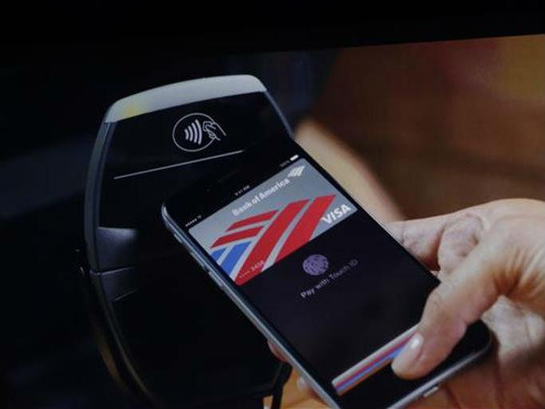
Apple Pay
Apple Pay is a mobile payment and digital wallet service by Apple Inc. Apple Pay lets users make payments using Apple devices. Users can use their iPhone, Apple Watch, or iPad to pay in a simple, secure, and private way.
One touch to pay with Touch ID
Pay with a single touch within apps
Add the credit or debit card to Passbook
http://www.theverge.com/2014/9/16/6204999/iphone-6-nfc-chip-locked-to-apple-pay#ooid=JrcHI3cDo6P9WbwZtLPsrmN47s3xpkL-

Slide 14
Advantages of Alipay Wallet
Allows customers to make transactions via mobile application, even on non-NFC enabled phones.
Alipay creates a unique, disposable barcode.
Two way payments are accepted by retailer.
Alipay has enabled payments to be made offline via sound wave technology.
Mobile terminal service includes all advantages of cross-border website payment.

Slide 15
Disadvantages of Alipay Wallet
Customers need to spend much time to set-up and make the verification through their email and mobile phone. Moreover, customers need the verify their bank account and their debit/credit card in order to link up with their Alipay account.

Slide 16
Advantages of Apple Pay
More convenient. Customers can pay in store without their debit/credit card.
More secure. Customers can provide their own touch ID which is unique and cannot be duplicated. In addition, Apple can protect customer’s accounts even if customers lose their device.
Keeps purchases private. Apple Pay doesn’t store the details of customers transactions. Also, customers do not need to show their Debit/credit card.

Slide 17
Disadvantages of Apple Pay
Only works using NFC technology. Apple Pay only compatible with iPhone 6 and iPhone 6 plus.
Must work within a network environment.
Not popular with all stores.

Slide 18
Applications and Solutions: AlipayWallet

Slide 19
Applications and Solutions: Tenpay

Slide 20

Privacy and Legal Issues
General Security Threats for NFC
Eavesdropping
Data Corruption
Data Modification/Data Insertion
Man-in-the-Middle Attacks

Slide 21
Privacy and Legal Issues (cont.)
Financial Consumer Protection
Disclosure and Transparency
Protection of Consumer Privacy
Protection of Consumer Data
Protection Against Fraud

Slide 22
Conclusion

